Slide 1
Data Aggregation and Analysis of Wearable Devices
DEC1610 Client: UnityPoint Health Advisor: Prof. S. Mitra Ben Kixmiller - Key Concept Holder Haythem Ebrahem - Key Concept Holder Brian Nguyen - Team Communications Leader George Ndemi - Key Concept Holder Johnathan Campbell - Team Webmaster Aakash Sheth - Team Leader
dec1610@iastate.edu

Slide 2
Project Uniqueness
We work with CyBiz
Gather business intelligence, market research
Healthcare resources
UPH staff (doctors, care coordinators, technology team)
Eventual integration into a larger system (Electronic Medical Records)
Real value comes from data analysis
Health professionals
Data scientists
Business Analysts
dec1610@iastate.edu
Notes:
haythem

Slide 3
Scope of Our Project
IoT has made wearable data easily accessible
Manufacturers like FitBit provide devices and web services
We want to query FitBit to gather information on useful data
We will gather heart rate, steps, weight, calories, and sleep
Present it to physician to find out what is useful
dec1610@iastate.edu
Notes:
Haythem

Slide 4
Functional Requirements
● Allows user login with their FitBit account.
● Display relevant data that’s collected from multiple types of device.
● Analyzes the data and show useful reports and graphs (mean and variance...) to user and providers.
● Maintain historical data (yearly - quarter yearly …) by saving it in database.
dec1610@iastate.edu
Notes:
Haythem

Slide 5
Non-Functional Requirements
● Security
○ No user can access any data of other users.
○ Users can erase their own confidential data that is stored in the phone
● Reliability
○ Runs 24/7 without interrupt
○ The application performs the function that the user expected.
○ Tolerate the use of software in unexpected ways.
● Performance
○ The data is compressed to help save storage
○ Energy efficient ( computation done on the server)
● Maintainability
○ Maintainable over time.
○ Different people can work on the application and adapting the system to new use cases
dec1610@iastate.edu
Notes:
Haythem

Slide 6
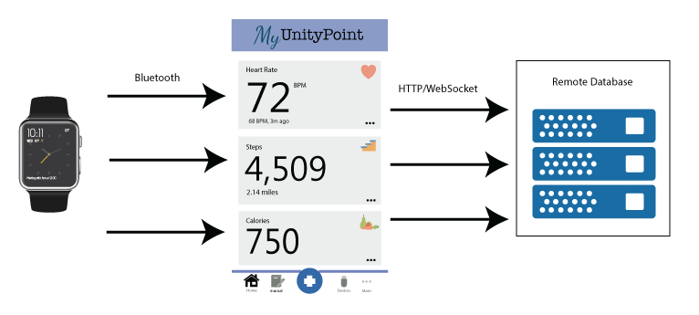
Conceptual Sketch (1st Iteration)
dec1610@iastate.edu
Notes:
The current design of the project. (Put Block diagrams and pictures here to help.) Make diagram for what it should ideally do - Jon

Slide 7
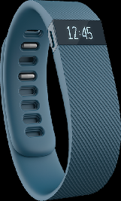
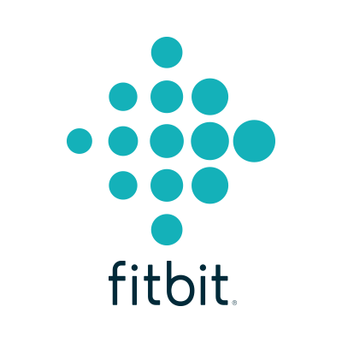
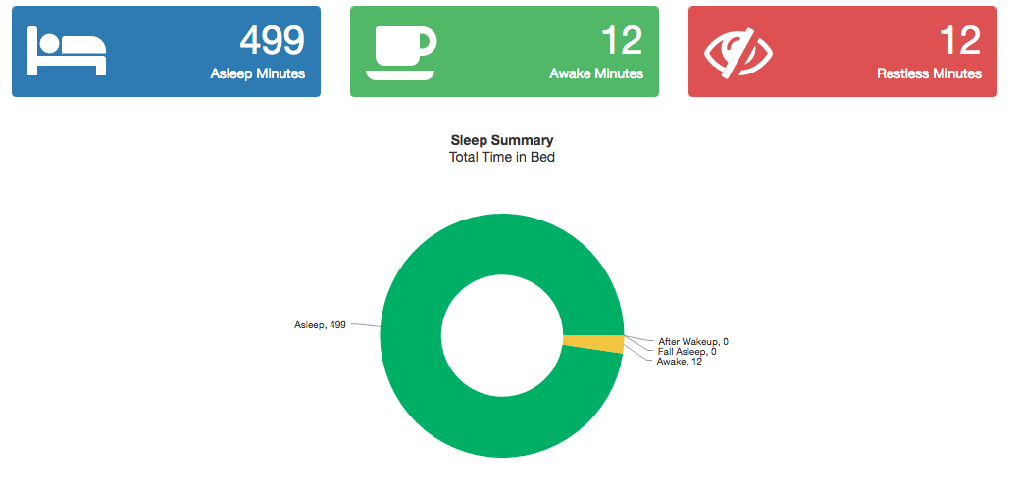
Conceptual Sketch (2nd Iteration)
CustomService
iOS Client
Server
Web Client
dec1610@iastate.edu
Notes:
The current design of the project. (Put Block diagrams and pictures here to help.) Make diagram for what it should ideally do - Jon

Slide 8
Process of Design
We had to make a design change from our initial system. The original design was to simply query data from a wearable device into an iOS application and eventually save that to a database.
That plan would have worked except we we unaware of the type of data we would be dealing with and how we would share that with a user whether that be a patient, physician, or for internal use like tracking and logging.
So we changed the design to be more modular. We also stripped down some components. Instead of developing further on the iOS app, we went with a web application, design proved to be much simpler and rapid, and also worked on mobile devices.
Notes:
clearly state how you have reached the current design (explain the process of design) and how the project progressed so far

Slide 9
Software and Hardware
dec1610@iastate.edu
Primarily a Swift project
Switched to web client
Spring Boot, Node, Angular
Azure (SQL DB)
MongoDB
Wearables (Apple Watch, Fitbit)
Notes:
Ben

Slide 10
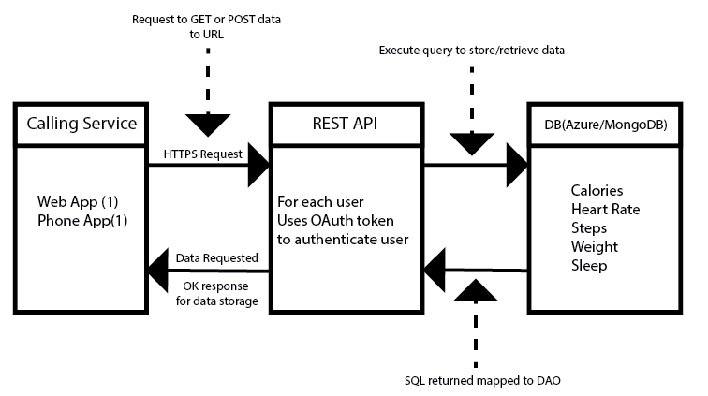
Rest API Design
Notes:
Jon

Slide 11
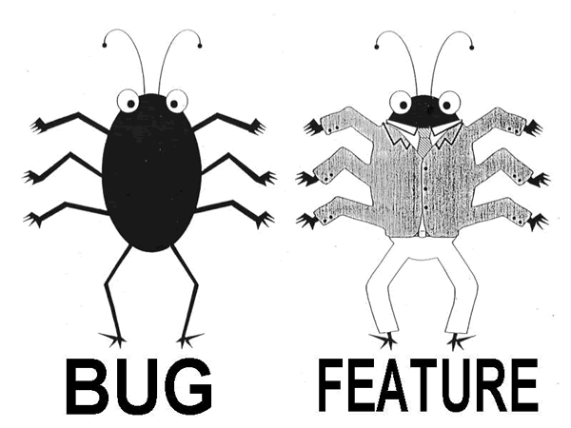
Test Plan
dec1610@iastate.edu
Integration with Github and Pull Requests
Agile Methodology
Used Trello
Three week iterations
Notes:
Ben

Slide 12
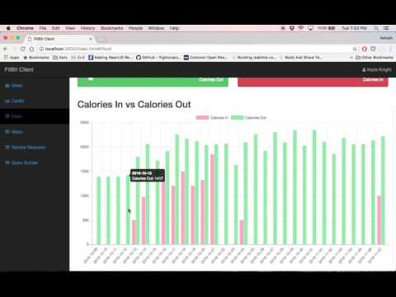
Demonstration

Slide 13
Demo 2 Brian

Slide 14
Demo 2

Slide 15
Obstacles
Requirements changed several time (AWS example).
Unable to get the API for some wearable device (Garmin API).
Deal with multiple technologies which made integration a challenge.
Different users for the application with different requirements and design.
dec1610@iastate.edu
Notes:
George
2-5 Technical Challenges we’ve faced and the solutions to these problems (spread these out throughout the presentation). Idea is for 3 -5 people to each say one challenge during their turn for talking.

Slide 16
Technical issues with Rest API and Azure DB
Database provided by UPH allows only local access, so development version of application cannot be tested with it.
To fix this we created a mock database that has a copy of the ‘production’ schema on a student hosted azure database to allow for local testing of API calls.
Free trial after free trial...
An added bonus of this is that if the web app or phone app is being run on the same computer (or network), we can use both at the same time to test the full process.
Ideally we will be making most requests for data (fitbit) from this API to consolidate data processing on the back-end
Notes:
Jon

Slide 17
Potential Risks and Mitigation
EMR authentication, pushing data from phone/database to EMR
Phones won’t connect directly to EMR. We should be able to push securely from the server containing the user information. This way database information won’t be stored on the phone.
EMR has highly personal information and we did not have direct access to a production copy. we created our own mock-up for testing and populated it with test data.
We don’t have full control of getting data from FitBit, Garmin, etc. devices.
Spend the money to get API access (Garmin)
dec1610@iastate.edu
Notes:
George

Slide 18
Milestones
dec1610@iastate.edu
Month | Item
Aug/Sept | Get data from Fitbit/HealthKit and show on the app. Create graphs for different views (steps, calories, sleep, etc.)
Oct | Create web application for a proof of concept. Able to show relevant graphs with the correct information from wearables for steps, calories, sleep, etc. Create Azure db Finish Spring REST Api Connect Spring to Azure db mocking current MongoDB
Nov/ Dec | Pushing data to the server. Setup Rest API on tomcat server provided by UPH Add graphs to show weekly, quarterly, and yearly data Data Trends. Report and presentation Hand over
Notes:
Add any missing milestones to this list.

Slide 19
CONCLUSION
dec1610@iastate.edu
Team member | Responsibility | Contributions
Aakash Sheth | Team Leader | Initial iOS app architecture Current web application prototype architect Administrative Tasks - Meetings, Docs
Ben Kixmiller | Key Concept Holder | Http get requests code Work with Jon and George to get back end work to connect Spring to UPH server
Brian Nguyen | Team Communications Leader | Implement Fitbit API with OAuth 2 to iOS app Build the admin webpage: create new user, search for clients, authenticate to server, etc. Store the data from user to server
George Ndemi | Key Concept Holder | Data analysis( Standard deviation, mean, min and max Worked on Amazon DynamoDb( cancelled later) Tested the sending data from the the app to Azure
Haythem Ebrahem | Key Concept Holder | Implementing local db (Realm) Implementing SQL db Configure AWS (Cancelled)
Jonathan Campbell | Team Webmaster | Updated/Managed website Mock up database Wearable study Spring REST API Creation
Notes:
Each person should edit what they’ve contributed to the project.

Slide 20
dec1610@iastate.edu
Thank you!
Any questions?
Notes:
Haythem

